Slide 1

Getting to know your home network…
(… and Network tools for the rest of the module)
This Photo by Unknown Author is licensed under CC BY-NC-ND

Slide 2

Agenda
Adapters/NICs/Connections
Virtual Machine Adapters
Bridging and other stuff
Home Network Analysis
Nmap
Wireshark
Packet Tracer

Slide 3
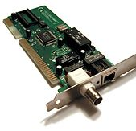
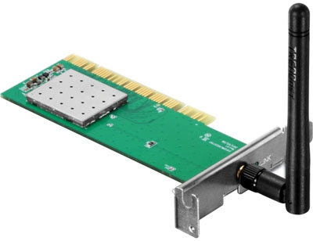
What’s a Network Adapter?
AKA Network Interface Controller(NIC), LAN adapter, Physical Network Interface.
Usually the piece of hardware built in to a device.
Interconnection point between a device and a network.
Actually does not need to be a physical thing
E.g. Your Virtual Machine has a Virtual Adapter
This provides a base for a full network protocol stack (More later)
On some Operating Systems, known as Network Connection/Device.
This Photo by Unknown Author is licensed under CC BY-SA

Slide 4
Networking tools and apps
For this module…

Slide 5
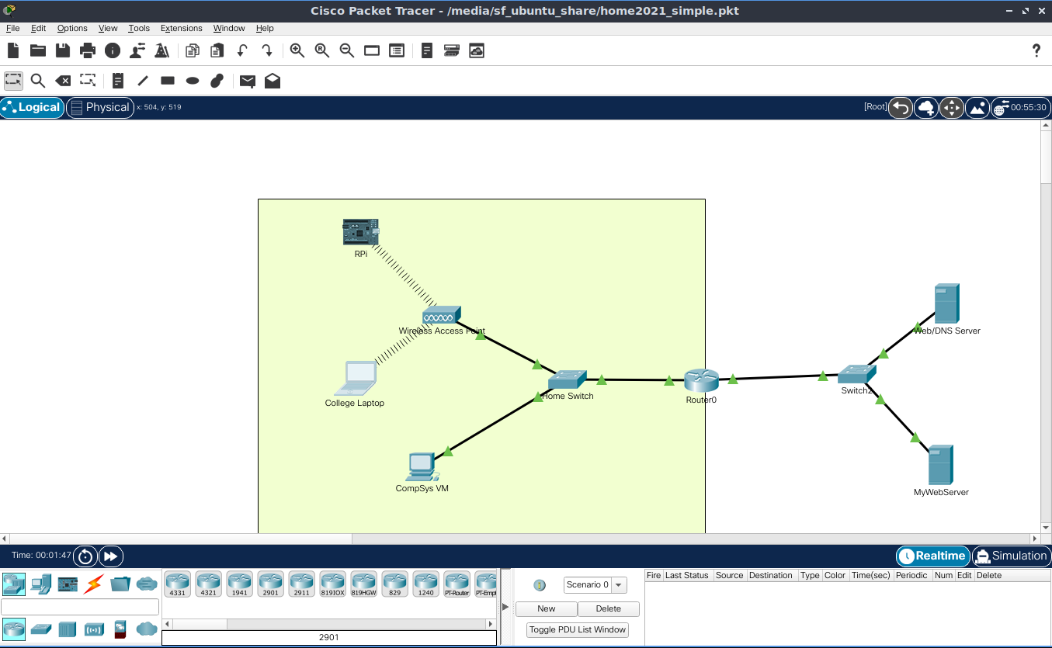
Packet Tracer
Network Simulator
Visual tool to create and run network topologies
Includes IoT Devices.

Slide 6
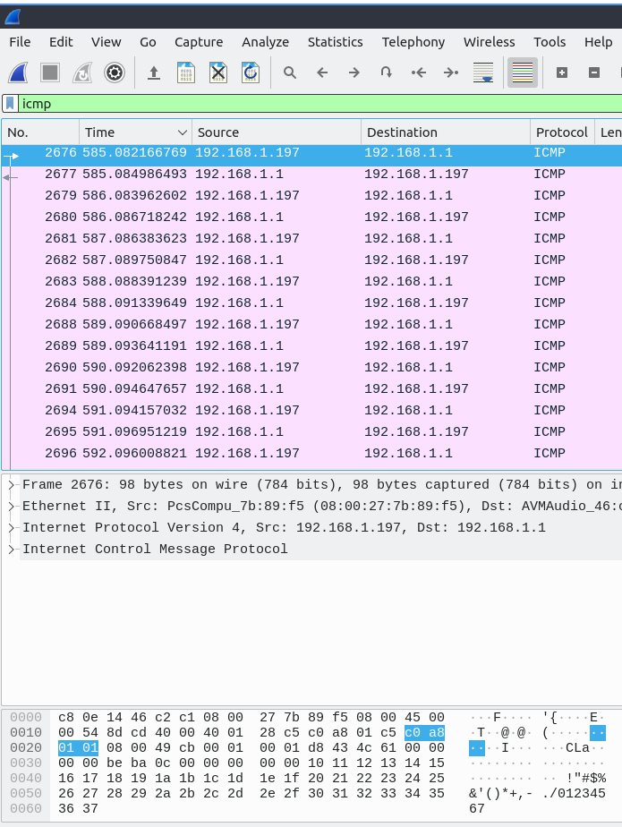
Wireshark
network protocol analyser
see what’s happening on your network at a microscopic level
https://www.wireshark.org/

Slide 7
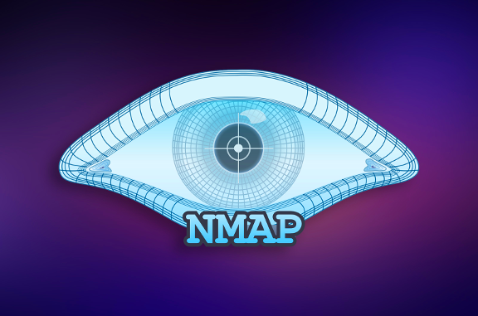
What’s Nmap
Short for Network Mapper
Utility for scanning a network
Used for IT auditing, Device/Asset discovery, Security profiling, Hacking!
This Photo by Unknown Author is licensed under CC BY-SA-NC

Slide 8
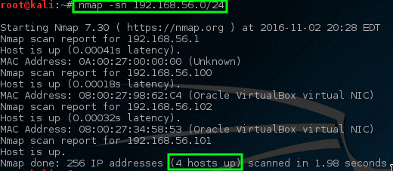
Nmap Usage – What’s out there.
Find out what’s on your network:
sudo nmap -sn 192.168.1.0/24
Detect Operating Systems: sudo nmap -O 192.168.1.234
Check open ports (more about this later) sudo nmap –sT 192.168.1.0/24
Check it all:
sudo nmap –sA 192.168.1.123
Command line tool:
You can use all the scripting goodness from previous section to do interesting stuff!
DEMO.
This Photo by Unknown Author is licensed under CC BY-NC

Slide 9
If you want to use Virtual Box…
Bridged Adapter
Shared Folders
Other Stuff…

Slide 10
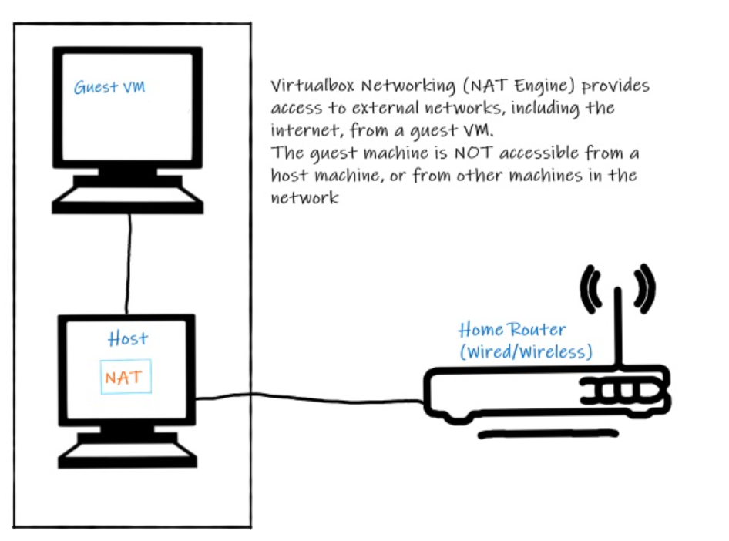
The Current VM setup
Up to now (using something called NAT)
Problem: Cannot “see” home network from Guest VM

Slide 11
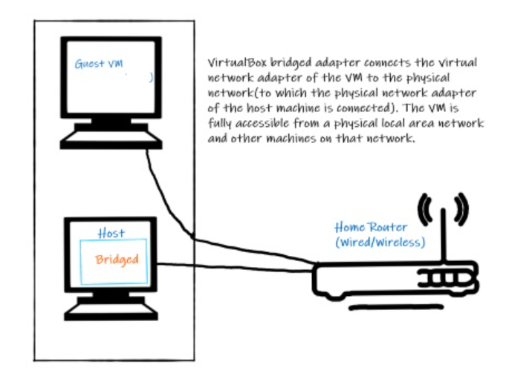
Preferred VM Setup
Bridged Adapter
Virtual Box connects the VM directly to the physical network via hosts network adapters
How does that work?
https://www.virtualbox.org/manual/ch06.html

Slide 12
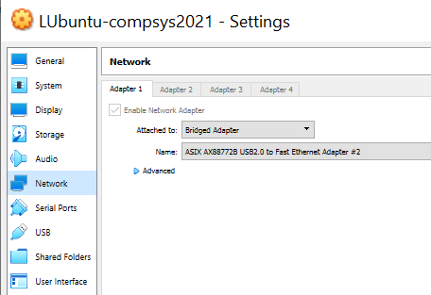


VirtualBox Bridged Adapter
To configure it, you need to select the Physical Adapter on the host the you want to use.
REMEMBER: if you change from wired to wireless connection ( or vice versa) you’ll have to change this
Dropdown automatically filled
with available Adapters/NICs on your host. Select the one one your using
to connect to your network

Slide 13

What if Bridged Adapter does not work…
Some systems may not support bridging(rare). (NIC hardware/Drivers)
You can set up your host with the tools required to do the labs (preferable to use VM though as it matches labs.)
You’ll need Packet Tracer, Wireshark, Python 3.x, Node
This Photo by Unknown Author is licensed under CC BY

Slide 14
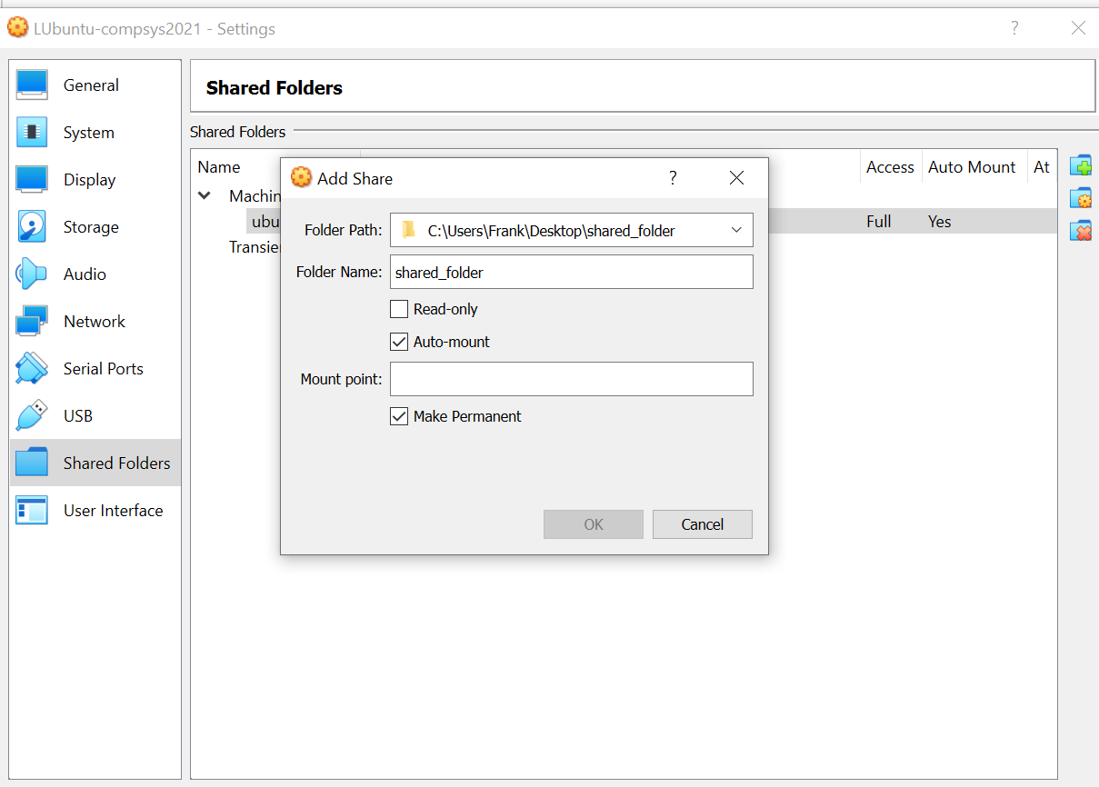



Shared Folder between VirtualBox guest and host.
Handy for moving files from guest to host/host to guest
In Virtual Box Manager, add the folder you want to share
Run the following at the command line in the VM:
sudo adduser compsys vboxsf
Reboot the VM!
https://www.howtogeek.com/187703/how-to-access-folders-on-your-host-machine-from-an-ubuntu-virtual-machine-in-virtualbox/

